Slide 1
Create an animated GIF with thumbnails
Dimensions 960x720

Slide 2
Process Info
Owner name | Rokia Baaror
Team | D&D
Resources
Tools | PowerPoint
Description | Animated gif with thumbnail we can use on the different pages on Docebo to animate content
 | Damien | AU Member | AU Member | AU Member | AU Member | AU Member | AU Member | AU Member | AU Member
Date | 29/11

Slide 3
Overview
Create an animated GIF with thumbnails
Step 1 – Insert thumbnails (specific case we used)
Step 2 – Add effects
Step 3 – Check all
Step 4 – Save and export it as an animated GIF
Conception of the animated GIF for the Partner Page of AFAH-ABC

Slide 4
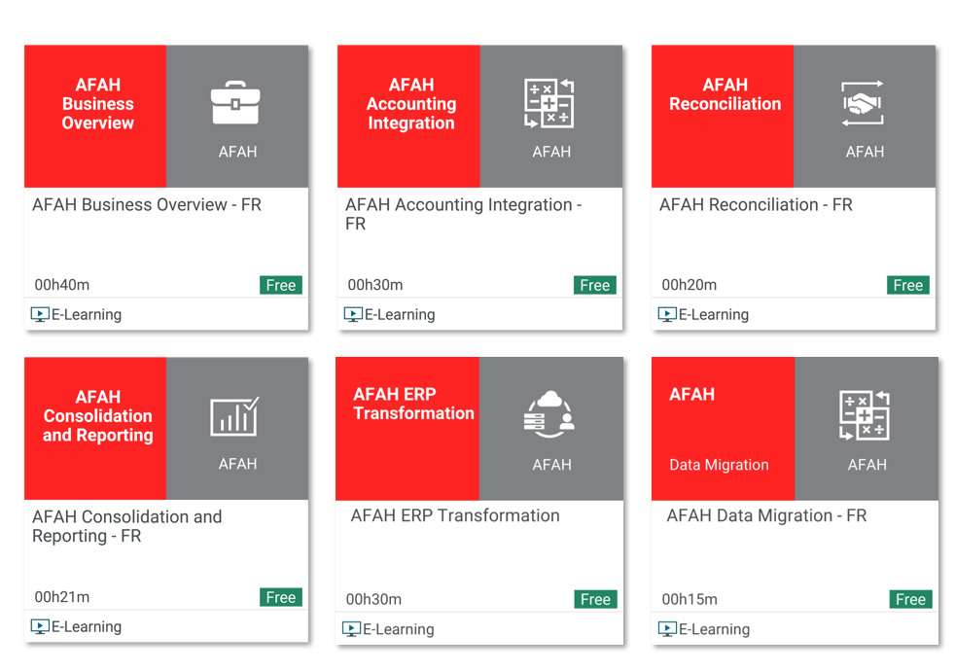

Step 1 – Insert thumbnails
Build your image by inserting thumbnails (or any image you'd like to animate) on the first slide.
And create as many slide as animation you need
You can only have one animation per slide to generate the GIF, as if it was a scrapbook design

Slide 5
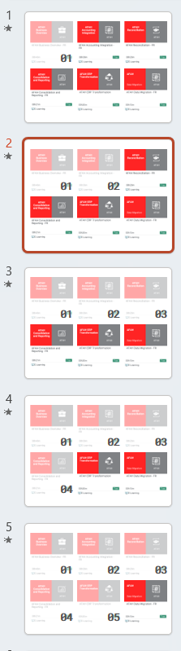
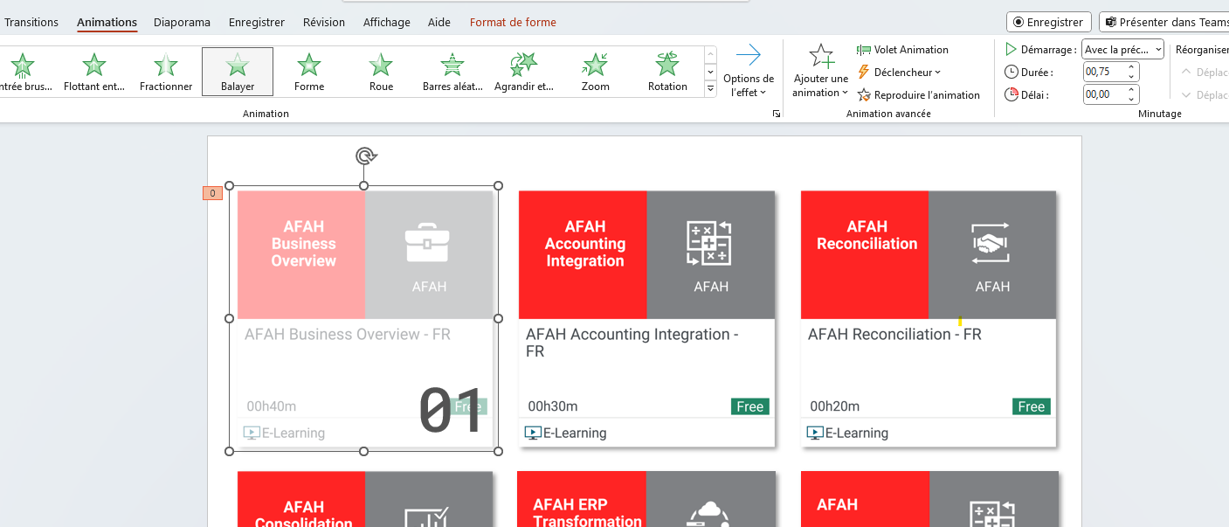
Step 2 – Add effects
4
In each slide add 1 effects you need and animat it :
Create and select the effect
Click on the “Animations” button in the top bar and choose one.
You can choose the duration you need,
And repeat the same steps for each slide.
4
4
2
3
4
1
4

Slide 6
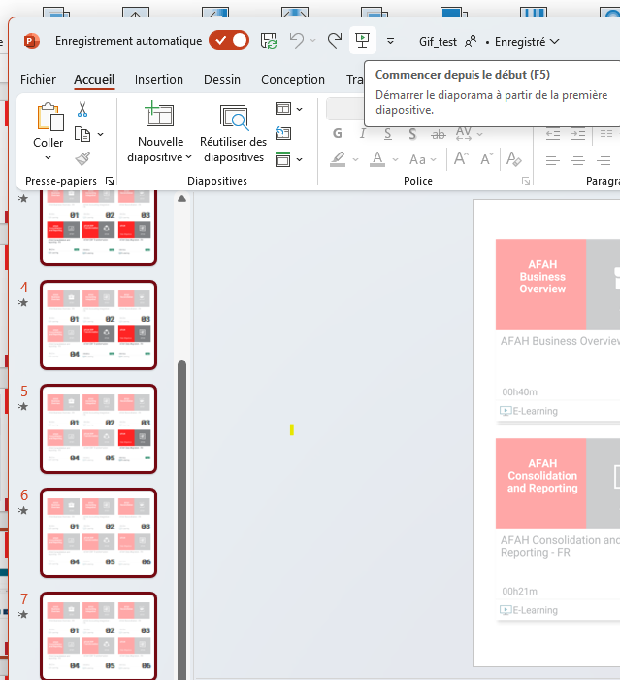
Step 3 – Check your final animation
You can check if all you build works correctly by selecting all slides on the left side then on the “slideshow” button in the top bar.

Slide 7
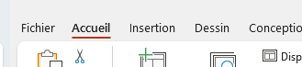
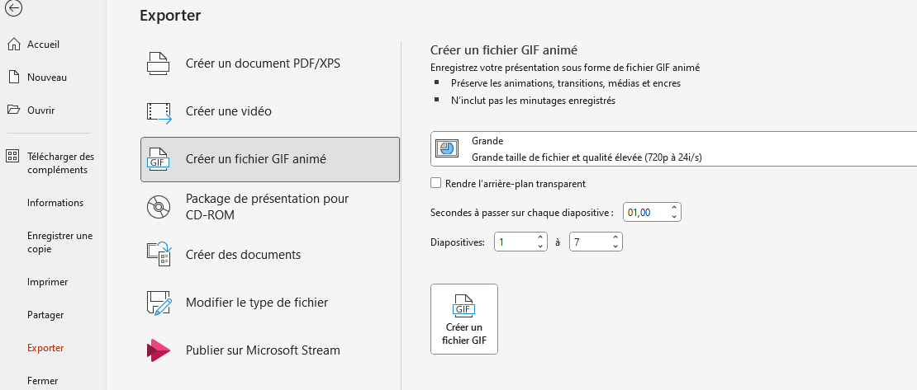
Step 4 – Save and export it as an animated GIF
Select all your slides then click on “Fichier” button.
Click on “Exporter” button.
Click on “Créer un fichier GIF animé” button.
Choose the size “Grande” and make sure you have all the slides you need.
Finally click to “Créer un fichier GIF”.

Slide 8
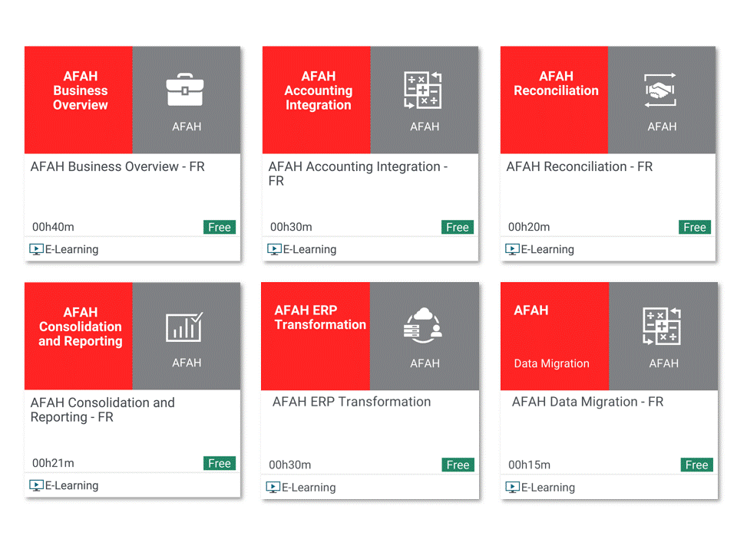
Final Result

Slide 9
Summary
Create an animated GIF with thumbnails
Step 1 – Insert your images and elements
Step 2 – Add effects (one per slide)
Step 3 – Check all
Step 4 – Save and export it as an animated GIF
Final Result

